Slide 1
SDMX Converter
Abdulla Gozalov

Slide 2
SDMX Converter
Software developed by Eurostat
Can be used to convert data from a variety of formats into SDMX and vice versa
Supports CSV, Excel, DSPL, and others
Can be used to transform….
Non-SDMX data to SDMX
SDMX to non-SDMX
SDMX format to another SDMX format

Slide 3
SDMX Converter: Applications
SDMX Converter is available as
Desktop application with a Graphical User Interface
Command-line application
Web service
Java library
Web application
Download from https://circabc.europa.eu/ui/group/088149e5-0472-405b-839b-57d5970052cc/library/ea54c8ee-5fe8-431d-826e-5e1a2835d405

Slide 4


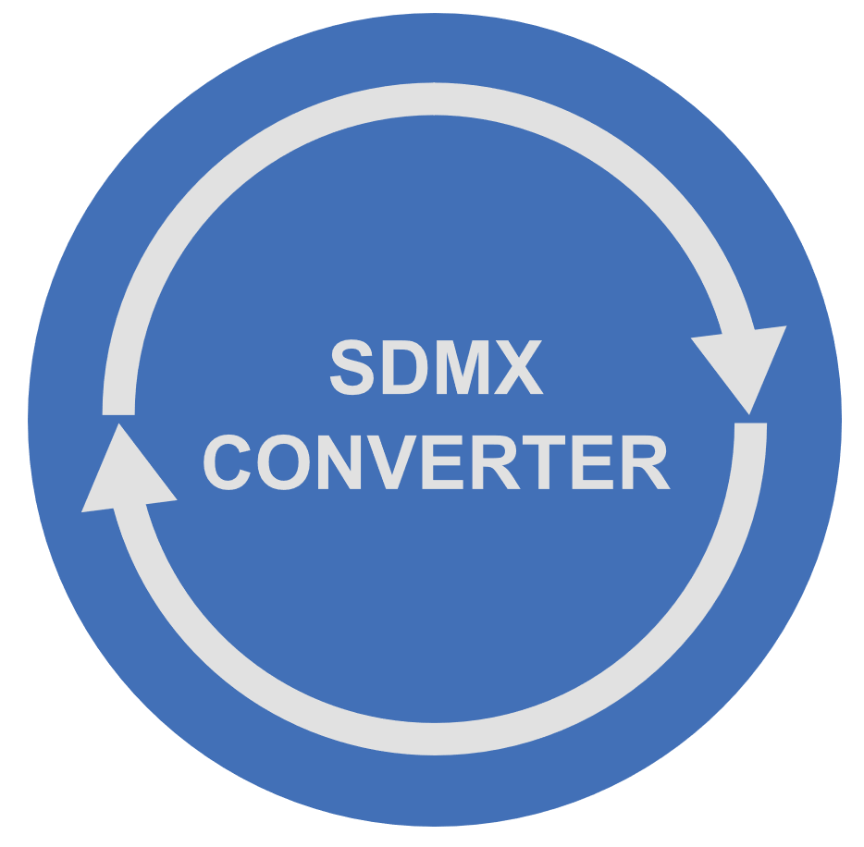


Converting data to SDMX
To transform data to SDMX using the SDMX Converter, you need
Source data as CSV, DSPL, Excel, etc.
A Data Structure Definition (DSD) according to which the SDMX dataset will be structured
Mappings that show how the source data maps to the concepts of the Data Structure Definition
As always in setting up SDMX exchange, configuring mappings takes the most time and effort

Slide 5
Using SDMX Converter with Excel
Data and mappings can be placed into the same spreadsheet
Mappings can also be supplied from an external file
Additional information can be added to facilitate data entry
E.g. code lists for validation and display of descriptions

Slide 6
Worksheet names
Worksheet named Parameters contains mappings
Shows how cells, rows, and columns map to the DSD dimensions and attributes
Multiple parameter sheets can be used if worksheets have different mappings.
In that case, worksheet named Parameter_mapping must show which parameter worksheets apply to which data worksheets
Parameter worksheet names must start with Parameter
Worksheet names starting with VAL are ignored
Can be used to store code lists or other ancillary information
Transcoding worksheet names must start with Trans
All other worksheets are considered to contain data and will be processed

Slide 7
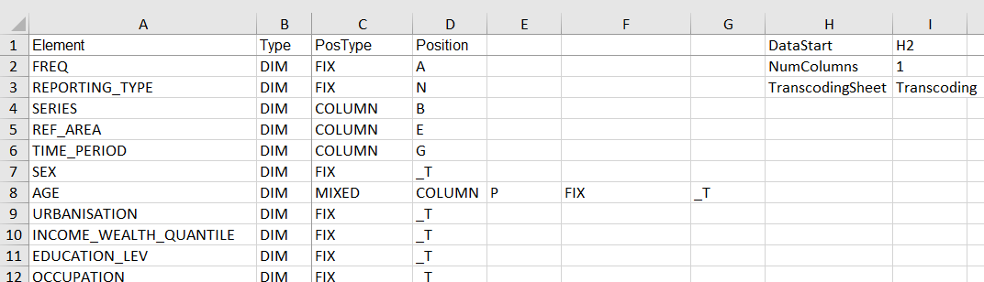
Excel Mappings: the Parameters worksheet
Mapping type
Cell where
data starts
Concept
Number of
obs. columns
Position or value
Concept
Role

Slide 8
Excel mappings worksheet
Element: name of the DSD concept
Type: role of the concept
DIM: Dimension
ATT: attribute
PosType: Mapping or position type
Position: position or value
DataStart: the first cell containing an observation
NumColumns: number of observations per row

Slide 9
Column PosType: mapping or position type
The following mapping/position types are supported:
CELL
ROW
COLUMN
FIX
OBS_LEVEL
MIXED
SKIP

Slide 10
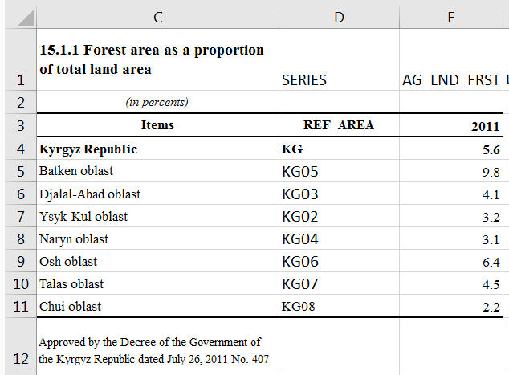
Mapping type: CELL
The value for the entire worksheet is specified in the cell provided in the column Position
E.g. if the worksheet is expected to only contain data for a single indicator, its code can be provided in a cell.

Slide 11
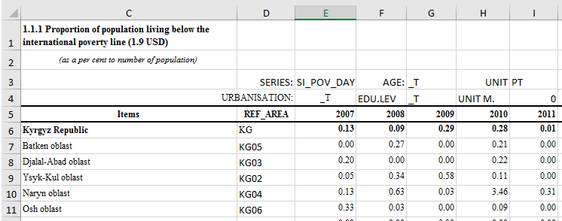
Mapping type: ROW
Values for the concept are stored in the row specified in column Position

Slide 12
Mappings type: COLUMN
Values for the concept are stored in the column specified in column Position

Slide 13
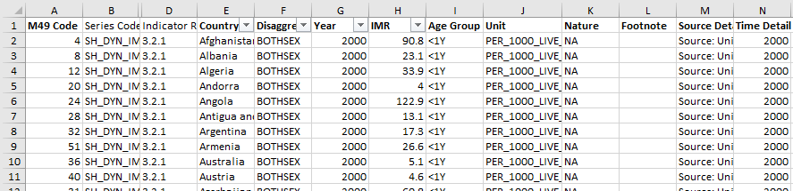
Mapping type: COLUMN (2)
Also used with record-based representation, when each row contains one record or observation, and each column holds values for one concept.

Slide 14

Mapping type: FIX
Fixed value for the entire dataset is stored in the column Position and does not appear in the data spreadsheet
E.g. if the data is always expected to be annual, frequency can be coded for the entire spreadsheet

Slide 15
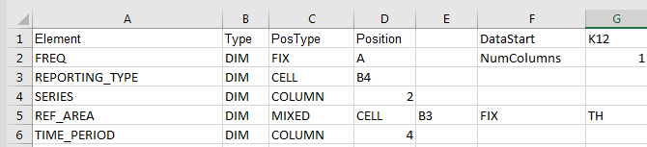
Mapping type: MIXED
The concept value is conditional
Can be used to provide a default value
“Use cell B3 for concept REF_AREA. If the cell is empty, use fixed value TH”

Slide 16

Mapping type: OBS_LEVEL
Can be used in to specify attributes attached at the observation level relative to the cell containing the observation.
E.g. when each row has multiple observations and their attributes.
“For attribute OBS_STATUS, use cell that is 1 column to the right of the cell containing the observation value. If that cell is empty, use the value in cell H14.”

Slide 17
Mapping type: SKIP
The concept value is not mapped
Can only be used with optional attributes

Slide 18

Transcoding
Transcoding refers to code mapping, when internal codes are different from DSD codes.
If codes in the spreadsheet do not match DSD codes, you can:
Add DSD codes to the spreadsheet and map as appropriate; or
Configure a transcoding worksheet as part of the dataset spreadsheet or in an external file.

Slide 19
Using DSDs and dataflows
SDMX Converter can use either a DSD or a dataflow to validate or convert datasets
Using datataflows is typically more strict because content constraints are usually attached to dataflows
For example, a structurally valid national SDG dataset will pass validation against the SDG DSD and country global dataflow DF_SDG_GLC, but will fail validation against the harmonized global dataflow DF_SDG_GLH
In addition, a structurally valid national SDG dataset will fail validation against the country dataflow DF_SDG_GLC if it contains invalid relationships among dimensions, e.g. Female sex with indicator “Land area covered by forest”.

Slide 20
Using SDMX registries
SDMX Converter can load structures from either a file or a registry
If a structure is loaded from a file, it must be complete with all required references.
At least, the file must contain a DSD, its Concept Scheme, and all referenced code lists
If structure is loaded from a registry, all referenced structures will be used automatically
Addresses of commonly used registries are provided by default. Address of any registry-compliant web service can be entered manually.

Slide 21
Transcoding
Transcoding refers to code mapping, when internal codes are different from DSD codes.
Transcoding can be stored within data spreadsheets or in external files. This is very useful when multiple sheets need to be mapped and reused.

Slide 22
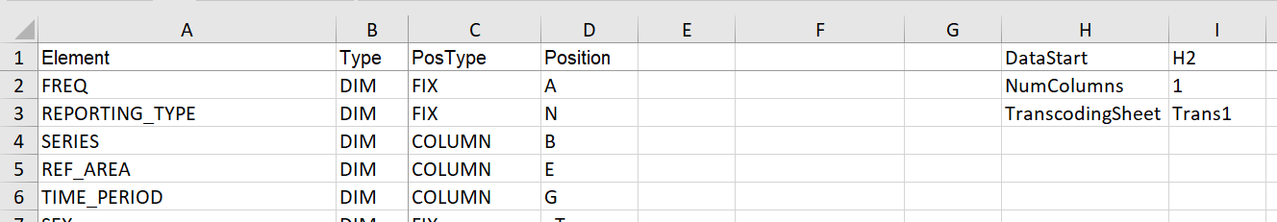
Transcoding worksheet: name
Transcoding can be supplied in a worksheet. The name of this worksheet must then be specified in Parameters.
The name of the parameter is TranscodingSheet.
This example specifies that transcoding is stored in a worksheet named Trans1. Any other valid name that starts with Trans can be used.

Slide 23
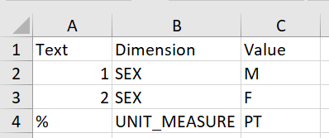
Transcoding worksheet: format
3 columns are used
Text: original code
Dimension: concept to which transcoding applies
Value: DSD corresponding to the original code
During conversion, original code specified in the Text column, will be substituted with DSD code specified in the Value column for the concept specified in the Dimension column.

Slide 24
THANK YOU!

